Slide 1

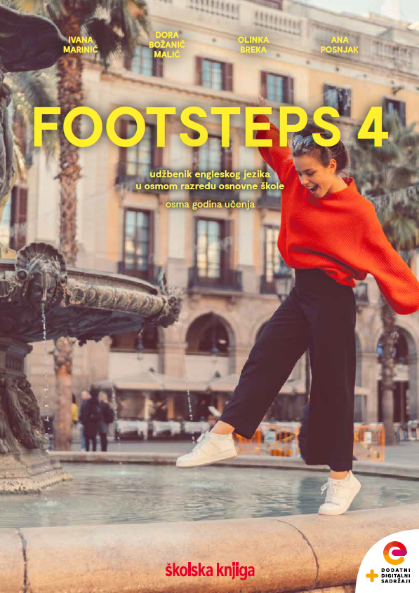

Culture spot 2
Middle Earth

Slide 2
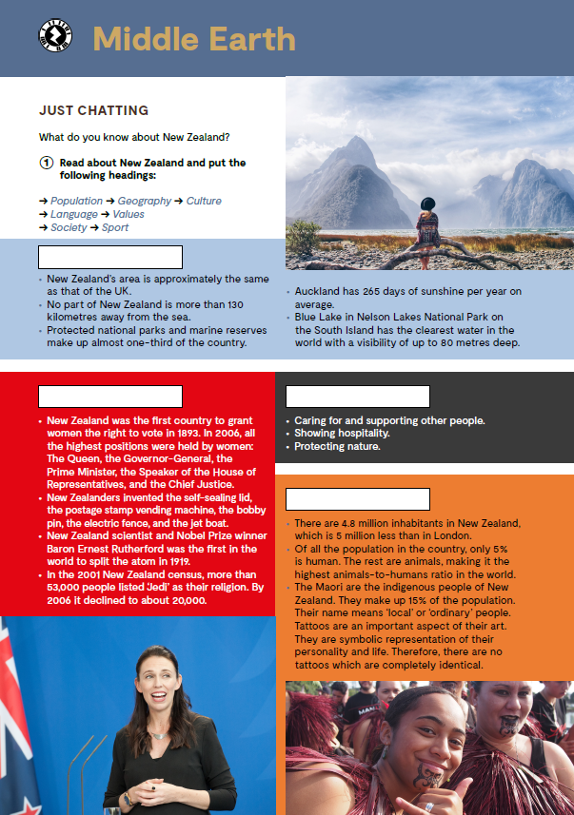
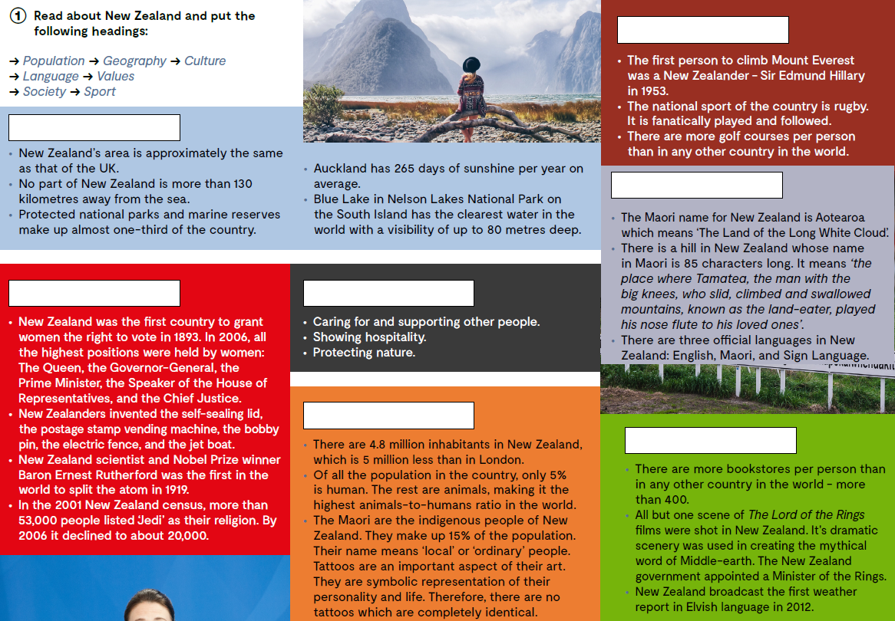
Open your book, page 122.
Sport
Where in the world can you find the smallest dolphins? Gdje na svijetu možeš pronaći najmanje dupine?
What else do you know about New Zealand? Što još znaš o Novom Zelandu?
Geography
Language
Society
Values
Population
Culture

Slide 3
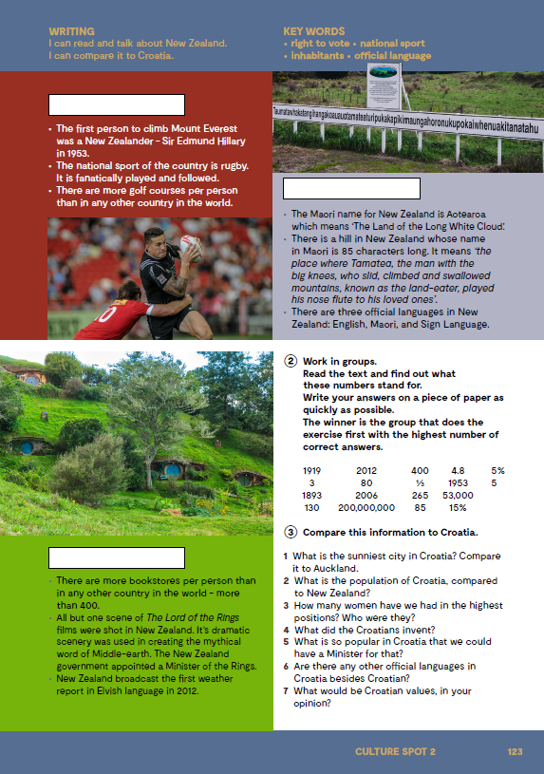
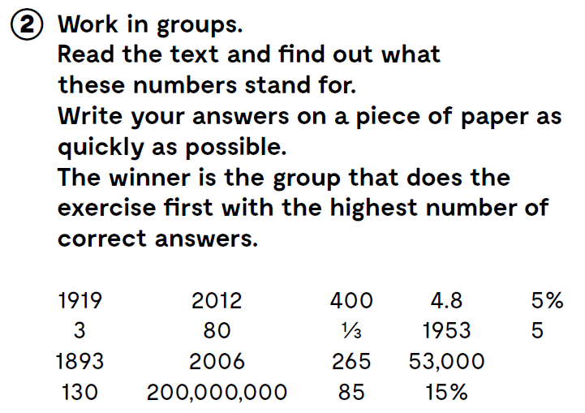

Slide 4
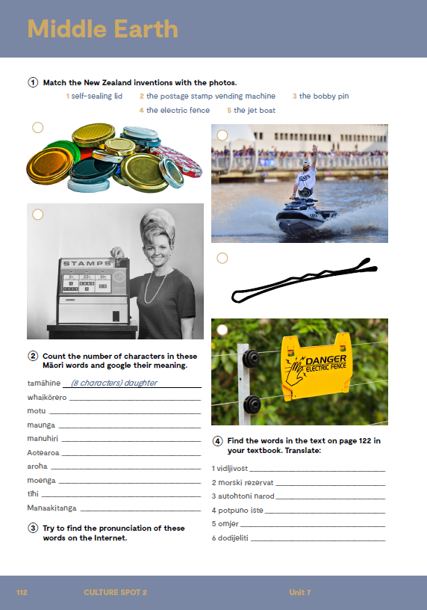
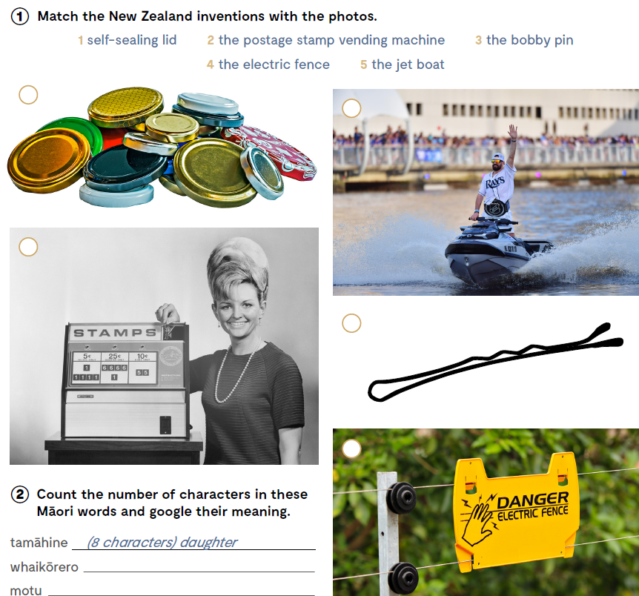
Open your exercise book, page 112.
1
5
2
3
4

Slide 5

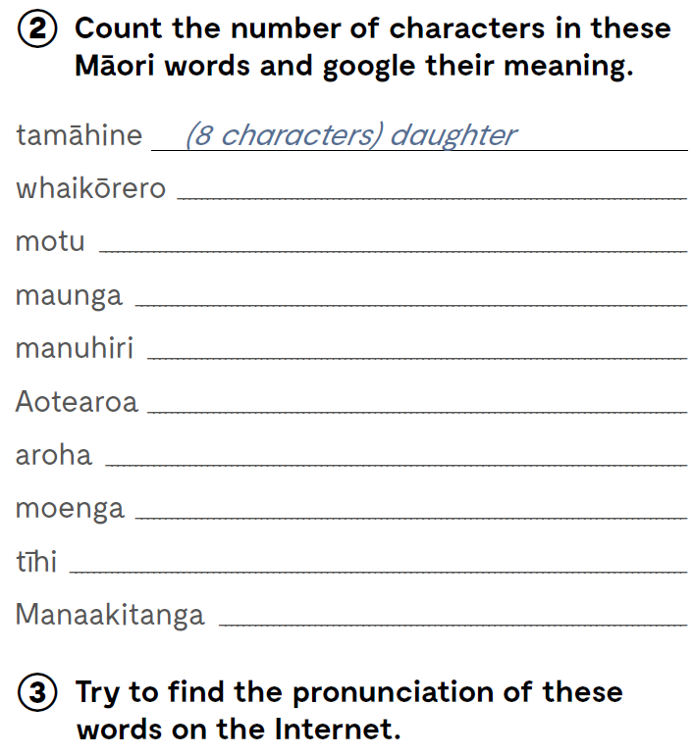
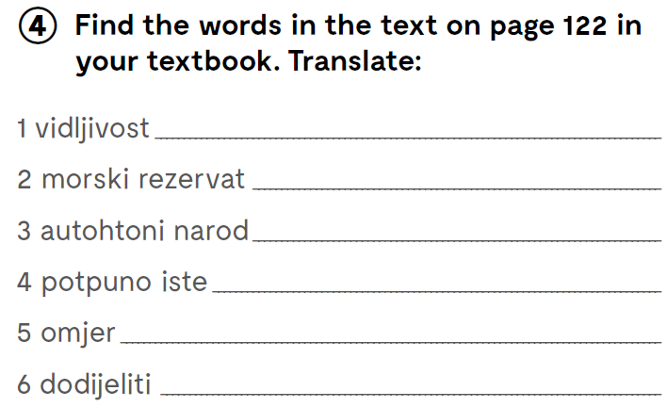
10; speech
4; island
6; mountain
8; guests
8; New Zealand
5; love
6; bed
4; top
12; hospitality
visibility
marine reserve
indigenous people
completely identical
ratio
grant

Slide 6
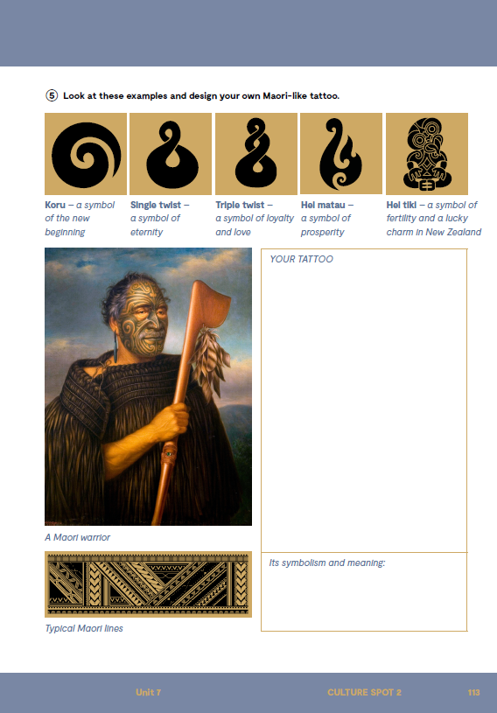
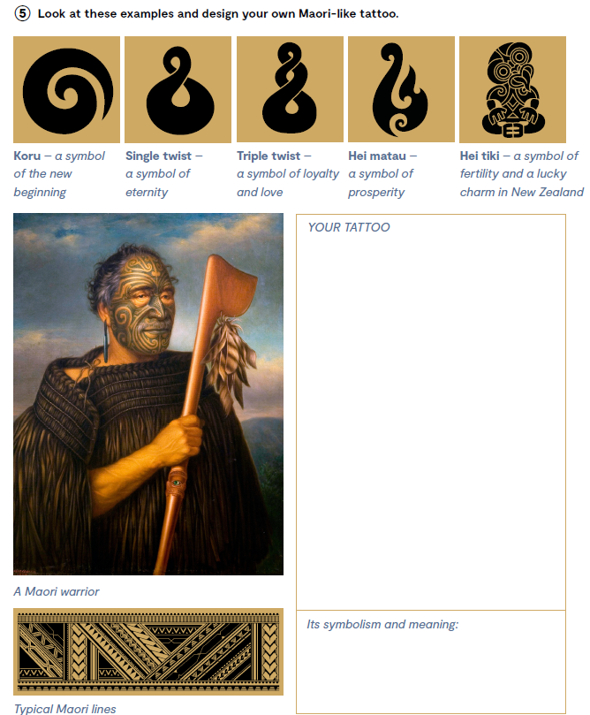
On the next page, page 133.
Look at these examples and design your own Maori-like tattoo.
Check yourknowledge https://wordwall.net/play/13565/304/617
Try to create your own quiz about New Zealand and share it with your friends.

Slide 7

